Slide 1
LAP Portfolio – BSE
High Level System Architecture Overview for SDA
Version 0.3
13th July 2026

Slide 2
Version History, Including Sign-Offs
The solution will through the following governance channels:
    LAP TWG
    SDA (Solution Design Authority): Principal architects for each impacted ALB (Arm’s Length Body) must be informed and may need to endorse the solution.
Person / Group | Role | Version Reviewed | Date of Sign-Off
LAP TWG | Endorsement to progress to CTWG | 0.1
LAP TWG | Endorsement to progress to CTWG | 0.2 | 3rd March 2026
LAP TWG | Endorsement to progress to CTWG | 0.3
LAP TWG | Endorsement to progress to CTWG | 0.4

Slide 3
Introduction

Slide 4
Introduction
Background
DEFRA seeks to exit from Civica-managed hosting and support arrangements by migrating and modernising seven critical Animal and Plant Health Agency (APHA) applications to secure, compliant, and sustainable Defra Cloud-based platforms. These legacy applications are currently distributed across Civica, Atos Datacentre, and hybrid configurations, and require remediation, rationalisation, and alignment with Defra’s cloud-first strategy and security standards.
We wish to undertake a project to move the solution towards alignment of the technologies and practices of the Defra Cloud Centre of Excellence (CCoE) definitions, demonstrating benefits against observed obsolescence, technical debt and security markers, without widespread implementation and significant business disruption.
Current State
On-Prem VM
(current state)
Target State
Cloud-native solution in Defra CCoE platform
(alignment to CCoE)

Slide 5
Introduction
Objectives
The primary objective is to design and implement a modern solution for migrating and modernising hosted application within the Defra Azure tenancy, that is compliant with the Cloud Centre of Excellence (CCoE) patterns and standards. Address overengineering and complexity by standardising on unified and strategically aligned component framework whilst moving away from obsolete platforms and services and their associated licencing/maintenance costs.
A secondary objective of this high-level solution architecture is to replicate the full current functional capability whilst enabling future scalability and enhancement opportunities. The design will ensure that existing service levels and resilience standards are maintained or improved on, supporting long-term operational efficiency and adaptability.
Drivers
The proposed solution will be planned to deliver benefits against observed obsolescence, technical debt and security markers, without widespread implementation leading to significant business disruption.
Obsolescence
Removal of outdated, end-of-life, end-of-support components, with limited or diminishing intellectual knowledge and capability.
Technical Debt
Removal of suboptimal technologies, and fragmented technology stacks that are not aligned to the Defra & CCoE strategic direction.
Security & Compliance
Remediation against known vulnerabilities, and enabling compliance to organisational security standards including remediation

Slide 6
Alignment to Architectural As-Is
Alignment to LAP Obsolescence Criteria
Current Status | Risk RAG | Points
Obsolescence | ● | Windows Server 2016 mainstream support ended on Jan 2022 with extended support till 2027. IIS version 10 is approaching end‑of‑life ( i.e.- till Jan 2027) with limited vendor support. ASP.NET Web Forms (v4.0) support ended by Jan 2016.
Technical Debt | ● | There are no DevOps CI/CD practices in place. Server patching and maintenance are performed manually. Current path-to-live (TEST →Prod) is not aligned to DDTS standards.
Security | ● | Inadequate security monitoring (e.g.- Traffic Anomalies, File System Security Events) which is not aligned with Defra Secure by design principles No data encryption at rest as SQL Server Transparent Data Encryption (TDE) is not enabled. No data sharing protocol or data encryption enabled at transit (confirmed by Atos DBA) Application does not enforce HTTPS. Database Credentials are exposed in plain text in the codebase. Authentication & Authorization flows are not following DEFRA standards.
● | Red = High Risk | ● | Amber = Medium Risk | ● | Green = Low Risk

Slide 7
Architectural As-Is

Slide 8
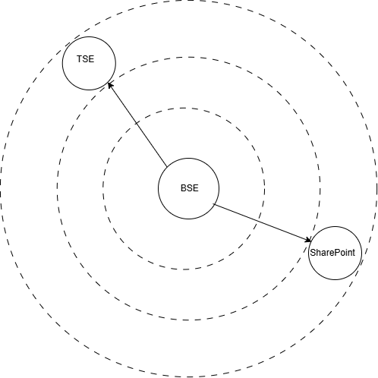
Architectural Current State
Context Model
The current BSE(Bovine Spongiform Encephalopathy) system manages suspected and confirmed positive BSE cases under Active and Passive Surveillance workflows. It supports RBSE allocation, case data entry, lab result updates, and provides access (by redirecting) to scanned documents that are uploaded offline into SharePoint by APHA team members.The system also provides search, reporting, and audit logging to maintain compliance and traceability.
BSE database pulls data from TSE(Transmissible Spongiform Encephalopathies) system and uses it to compare with own bovine/cattle case data.

Slide 9
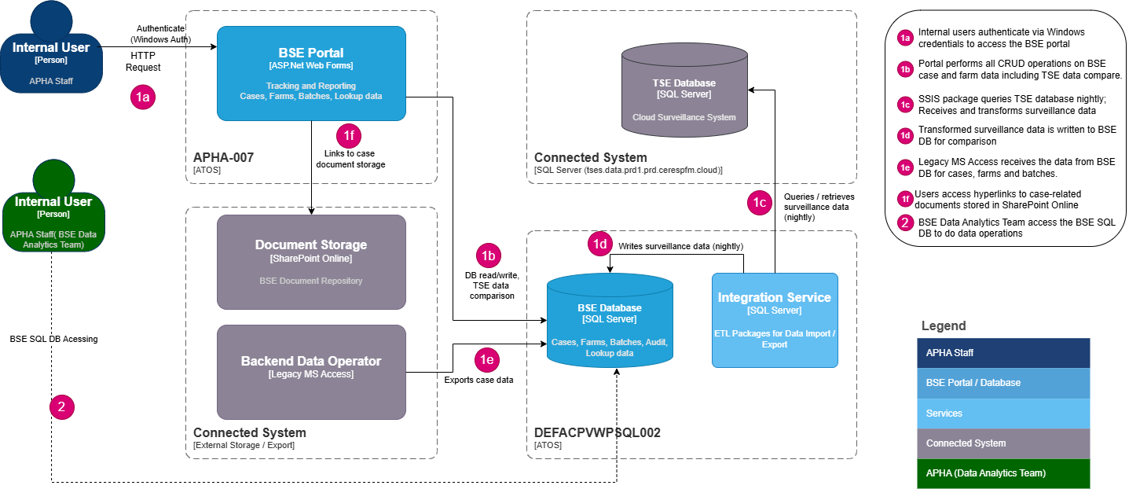
Architecture Current State
Logical architecture ( As-Is):

Slide 10
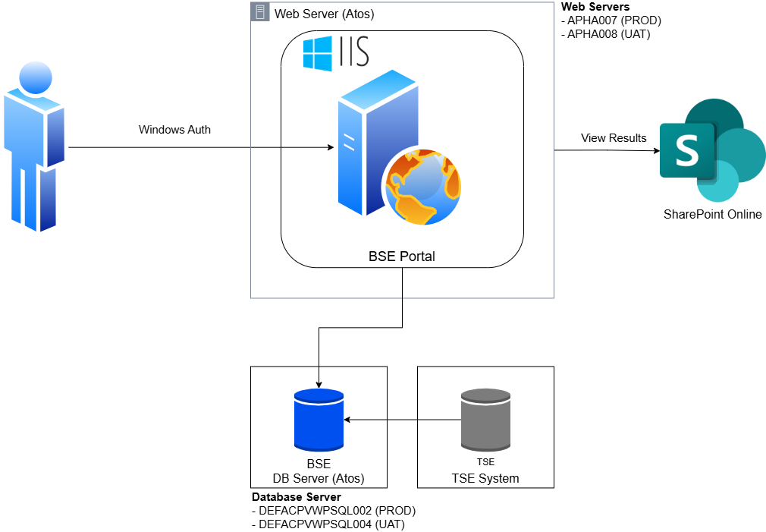
Architectural Current State
High Level As-Is:
Key Components
Login (Windows Authentication)
  Users authenticate using Windows Authentication for accessing the application
2. Web Server & IIS Server
  Web Server hosts the IIS Server running the BSE Website.
  Two different environments given below:
    APHA-007 (PROD) / APHA-008 (UAT)
3. Database Servers
  Physical servers:
    DEFACPWPVSQL002 (PROD)
    DEFACPWVTSQL004 (UAT)
  Database instance:
    BSE
4. SharePoint Online (SPOL)
  SharePoint online is used to View scanned forms.

Slide 11
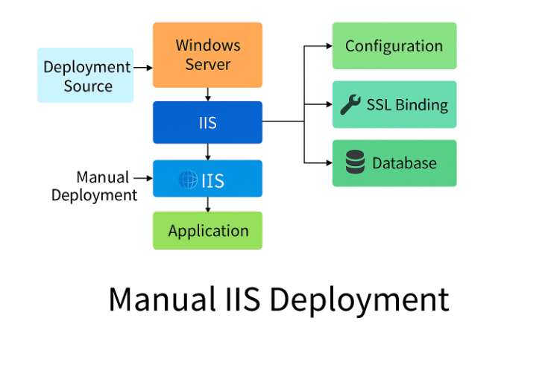
Architectural Current State
Deployment Model
Deployment Source and Transfer
  The application package is prepared and manually transferred to the Windows Server hosting IIS for deployment.
IIS Configuration
  IIS is configured with application pools, SSL bindings, and environment-specific settings to host the application securely.
Application Deployment and Validation
  The application is deployed to the designated IIS site, followed by validation of database connectivity.
Smoke Testing
  Smoke tests are performed to verify that the deployed application functions correctly before going live.

Slide 12

Architectural Current State
Server / Database Inventory( As-Is)
Machine Name | Specifications | Disk Space | Memory | No. CPU Type / Speed | Category | Environment
APHA-007.cvlnt.vla.gov.uk | OS: Windows Server 2016 Datacentre | 200 GB | 8 GB | 4/3093 | Web Server | PRODUCTION
DEFACPVWPSQL002 | OS: Windows Server 2019 standard DB: Microsoft SQL Server 2022 (8Core) | 6824 GB | 64 GB | 8/3093 | Database Server | PRODUCTION
APHA-008.cvlnt.vla.gov.uk | OS: Windows Server 2016 Datacentre | 200 GB | 8 GB | 4/3093 | Web Server | UAT
DEFACPVWTSQL004 | OS: Windows Server 2019 standard DB: Microsoft SQL Server 2022 | 960 GB | 64 GB | 8/3093 | Database Server | UAT

Slide 13
Data Journey As-Is

Slide 14
Data Journey As-Is
High Level Data flow journey
BSE System: is used by Apha users (authenticate through Windows Authentication) to view and manage BSE case information. All case-related data is entered into the system manually. The system also provides administrators with functionality to maintain user roles, user account details, and reference data.
The BSE system is also integrated with SharePoint, enabling users to retrieve scanned case forms directly from the SharePoint repository.
BSE Database: is SQL Server 2022 (hosted on DEFACPVWPSQL002) and the central repository for all BSE case related data. It contains several key data domains:
  BSE case details
  Roles and User’s data
  Reference and lookup data
Data Integration: There are 2 SQL Server Integration (SSIS) packages:
  BSESS Import Package pulls surveillance data from the TSE database into the BSE system. The TSE Database provides additional data such as Animal records, Laboratory samples, Testing group and Laboratory result code.
  BSE Access Export package extracts data from core BSE Database tables and populates four dedicated export tables within the same database. These tables are consumed by MS Access users to view Herd Sizes, Cases, Farms, and Relations data.
Data Access: Users connect to BSE Database to retrieve data for Business Intelligence (BI) reporting through:
  MS Access
  SQL Server Management Studio (SSMS)

Slide 15
Architectural To-Be

Slide 16
Design Decisions
# | Decision Area | Design Consideration | Decision | Rationale
DD001 | Hosting | Adherence to cloud first strategy. The use of CDP and other containerisation platforms considered vs the use of a PaaS service. | Use Azure Container Apps with Linux containers for hosting the modernised .NET 10 application. – CDP not deemed appropriate due to additional effort. | Azure Container Apps is a serverless container platform built on Kubernetes Linux containers provide portability, environment consistency, and cloud-native scalability aligned with Defra’s modernisation strategy. CDP does not support SQL Server. Currently it supports MongoDB, hence the use of CDP discounted.
DD002 | Database | The use of CDP supported DB services-MongoDB or other DB services vs the use of a Azure SQL Database The strategic direction is to use PostgreSQL where viable. | Use the Azure SQL Database. | Azure SQL Database integrate seamlessly with .NET development tools (ADO.NET, Entity Framework, Azure DevOps). The application currently uses an MS SQL DB and choosing Azure SQL over alternative database platforms avoids the significant redevelopment effort
DD003 | Monitoring and Alerting | The use of other monitoring & alerting services vs the use of Azure App Insights | Azure Application Insights provides first-class support for .NET 10 containerised applications deployed in Azure Container Apps | Azure Application Insights automatic provide dependency tracking and distributed tracing. Seamless integration with Azure Monitor and Log Analytics, providing lower configuration overhead.
Notes:
Kenneth

Slide 17
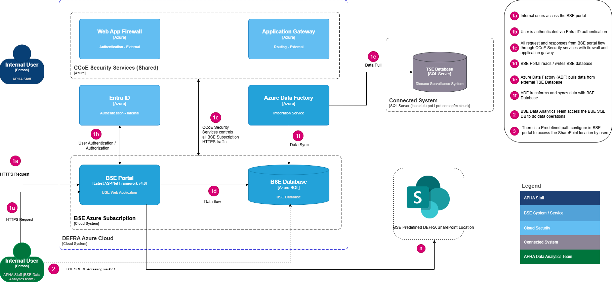
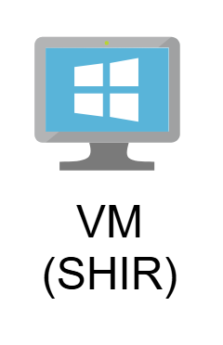
Architecture Future State
High Level To-Be: Logical System Architecture
Notes:
HTTP/HTTPS
Security some highlights

Slide 18
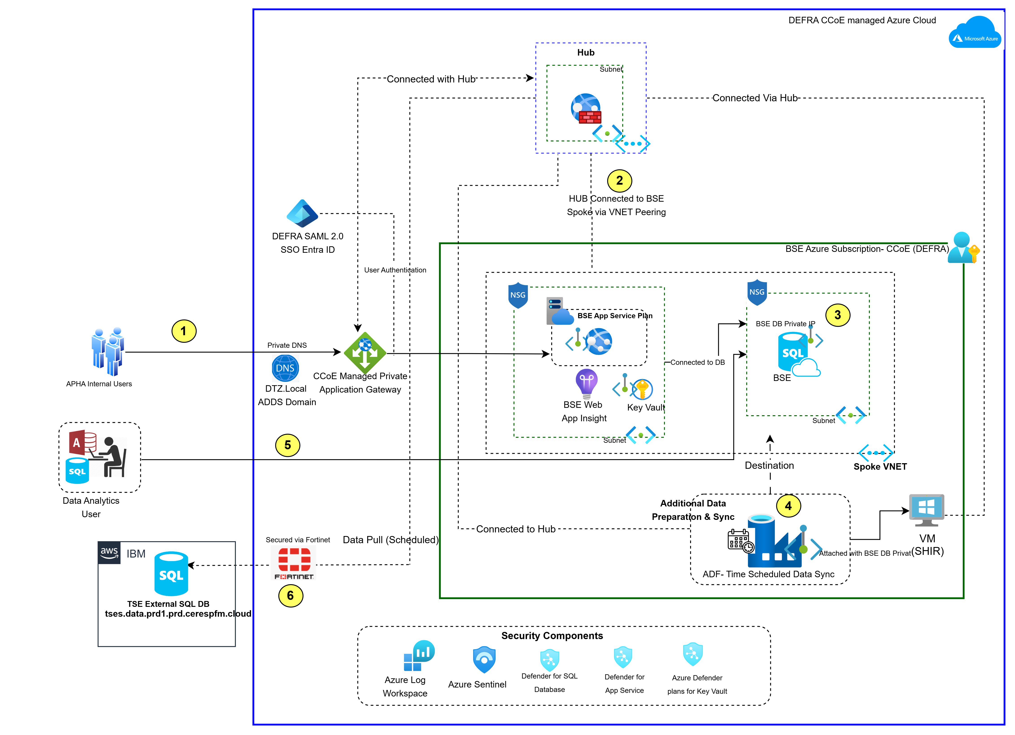
Architecture Future State
High Level To-Be: Cloud Architecture with Hub-Spoke pattern
User Access - User Traffic enters the environment through the Hub, where the Azure Firewall and Private DNS provide secure routing and name resolution. This ensures all inbound and outbound flows are centrally governed before reaching spoke resources.
Hub & Spoke Connectivity - VNET peering enables secure communication with the hub and database spoke while maintaining isolation. The BSE containerised application (.NET 10, Linux containers) and supporting services operate within the spoke network, protected by NSGs and integrated with Azure Entra ID, Key Vault, and App Insights.
Database Tier - The BSE SQL Database is hosted in a dedicated spoke, exposed only through private IP and controlled via granular NSG rules. This tier stores all application data and provides secure, high‑performance connectivity to the application tier.
Data Synchronisation via ADF - Azure Data Factory dispatches the pipeline to a Self-Hosted Integration Runtime running on a burstable B-series Azure VM, right-sized for the once-daily batch pull and using accumulated burst credit for peak throughput. The VM connects outbound via the Hub, where a FortiGate firewall rule (added by the Defra network team) permits traffic through to the TSES database; ADF no longer connects to TSES directly.
Business Users accessing BSE database - Data Analytics users connect to the BSE Database using SSMS from AVD with Read only access
External Connectivity -. Firewalls will be opened on Defra and IBM to pull data from TSES database into BSE database.
Notes:
Costing for new service based on above architecture

Slide 19
Roles & Responsibilities
High Level To-Be: Actions, actors & permissions
Responsibility | AMS | Data Analytics Users (APHA Staff) | Internal Business Users (APHA Staff)
Access to BSE Live Portal | ● | ● | ●
Access to BSE Live Portal for data manipulation | ● | ● | ●
Access to BSE Live Database (Read-only) Via SSMS in AVD | ● | ● | ●
● | = Yes / Responsible | ● | = Not Applicable / No Access

Slide 20
Direct SQL Access Via AVD: DEFRA Secured-by-design principles
● | Monitoring | ● | Audit | ● | Access Control | ● | Data Protection
Additional Security Controls for Direct SQL Access Via AVD
Category | Key Points
Protective Monitoring | All SQL logins and query executions are logged via SQL Auditing to Log Analytics, enabling full traceability. Azure Sentinel correlates read‑only user activity with identity logs to detect threats or abnormal access patterns. Defender for SQL monitors for suspicious or high‑risk behavior such as unusual data extraction, credential misuse, or query anomalies.
Data Encryption & Protection | All SSMS connections to Azure SQL enforce TLS 1.2+ encryption in transit end‑to‑end. Transparent Data Encryption (TDE) secures all data at rest within the BSE database. Data Analytics users receive read‑only SQL roles (db_datareader) only, with no rights to modify data, objects, or schemas. MFA and Conditional Access policies help prevent unauthorized use of SSMS from unmanaged devices or locations.
Isolation & Lateral Movement Protection
Category | Key Points
Isolation (Despite Direct Access) | Data Analytics users connecting through SSMS from inside Azure Virtual desktop are restricted to a single authorized Azure SQL database, preventing visibility of any other databases in the environment. Query execution is constrained to only the permitted database, ensuring users remain fully isolated from other workloads
Lateral Movement Protection | Database‑level permissions ensure users cannot list, browse, or connect to other SQL instances or datasets, stopping lateral movement within the data tier Access to master, model, msdb, and any neighboring databases is denied, preventing privilege escalation or unauthorized dataset access. Operations such as cross‑database queries, linked server connections, metadata inspection, or stored procedure enumeration are blocked by permissions.

Slide 21
Infrastructure To-Be
Service category | Services | Resilience | Configurations
Databases | Azure SQL Database | Zone-redundant (ZRS) | Zone Redundant Database, vCore, General Purpose, Serverless, Standard-series (Gen 5), 8 max vCores, ZRS Back up Storage. Memory : Autoscale (1 vCore ≈ 3 GB RAM) Max Storage – 200GB
Compute | Azure Container Apps | Zone‑Redundant (ZRS) | Consumption + Dedicated Plan; Linux containers running .NET 10; 2 vCPU(s), 4 GB RAM per replica; min 1, max 3 replicas; Includes autoscaling.
Compute | Azure Virtual Machine (SHIR host) | Single node across all environments (Dev/Test/Pre-Prod/Prod) | Windows Server VM hosting Self-Hosted Integration Runtime (SHIR) for ADF-to-TSES connectivity. Burstable B-series SKU (e.g. Standard_B2ms) - accumulates credit while idle and bursts for the once-daily batch pull; the daily data volume is consistent across environments so the same SKU is used in Dev/Test/Pre-Prod/Prod. Includes managed OS disk and static outbound IP.
Compute | Azure Data Factory | Zone‑Redundant (ZRS) | Azure Data Factory V2 Type, 8vCores,16 vCore
Monitoring | Azure Monitor | Default | Azure App Insight Application Insights: 1 GB Daily Analytics logs ingested, 3 months Data retention, 1 Standard Web Test, 5 Minutes Execution frequency, Executing for 730 hours;
Security | Key Vault | Default | 100-200 TPS
Networking | Azure Private Endpoints | Default | 3 in total . 1 Endpoints X 730 Hours, 100 GB Outbound data processed, 100 GB Inbound data processed
Networking | Static Outbound IP / NAT Gateway (SHIR egress) | Default | Reserved IP for IBM firewall whitelisting Standard Public IP (Dev/Test); Zone-redundant NAT Gateway for the HA pair (Pre-Prod/Prod), required so IBM can whitelist a stable outbound IP.

Slide 22
Technology Mapping : AS-IS vs TO-BE
Tech Stack | AS-IS Technology Stack | TO-BE Technology Stack | Remarks
Technology Framework | Microsoft .NET 4.0 | Microsoft .NET 10 | Aligned with Microsoft Tech Stack, and in-line with Defra’s approved technology.
Programming Language | VB.NET | C# | Modernisation from VB.NET to C# improves maintainability, performance, and aligns with Defra’s approved technology stack.
Web Framework | ASP.NET Web Forms | ASP.NET Core Razor Pages | Migration from legacy Web Forms to ASP.NET Core Razor Pages enables improved performance, testability, cross-platform support, and modern cloud-native deployment.
Application Hosting | Windows Server 2016 / IIS | Linux Containers (Azure Container Apps) | Containerised deployment on Azure aligns with Defra’s cloud-first strategy, providing scalability, portability, and cross-platform support on Linux.
Database | Microsoft SQL Server 2022 | Azure SQL Database | Aligned with Microsoft Tech Stack, and in-line with Defra’s approved technology.
Deployment | Manual IIS deployment | Azure DevOps CI/CD | Aligned with Defra’s approved DevOps practice.
Code Repository | Civica managed | Azure DevOps Repo(GitHub) | Aligned with Defra’s standards practice.

Slide 23
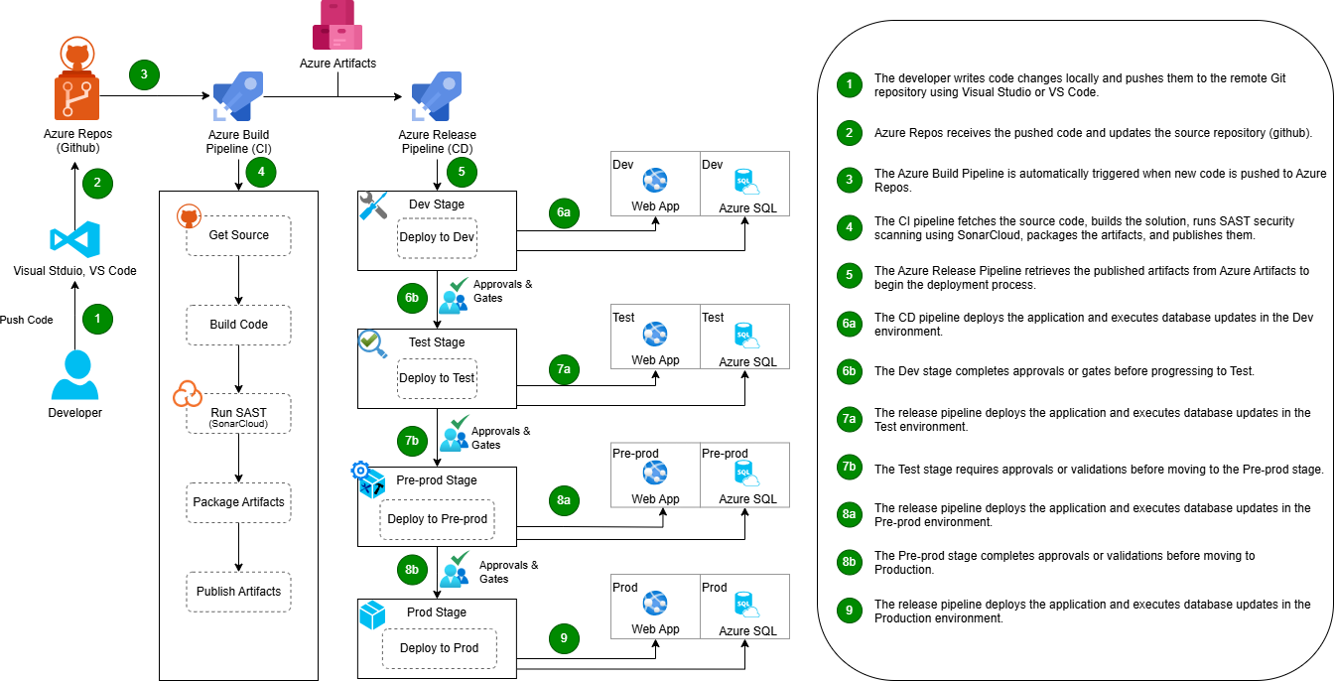
Architecture Future State
High Level To-Be: Deployment Architecture

Slide 24
Alignment to LAP Success Criteria
Alignment to Architectural To-Be
Current Status | Risk RAG | Points
Obsolescence | ● | Application hosting will be on Azure Container Apps using Linux containers Modernising to .NET 10, C# and Razor Pages, deployed in Linux containers
Technical Debt | ● | Infrastructure-as-Code (Bicep) replacing manual configuration. Automated PaaS patching eliminating on-premises maintenance burden. Dedicated Dev/Test/UAT/Production environments in Azure removing validation-in-production risk. CI/CD pipelines (Azure DevOps-Github) deployments reducing operational risk and migration windows.
Security | ● | Azure Entra ID for authentication Azure Key Vault for secrets management Azure Container Apps under secured firewalls & VNET’s. Azure Private Endpoints for connectivity. Azure Web Application Firewall (WAF) for threat protection. Azure Monitor and Sentinel for security logging. VNet peering for service-to-service authentication. Full Secure-by-Design compliance with Defra security standards.
● | Red = High Risk | ● | Amber = Medium Risk | ● | Green = Low Risk

Slide 25
Business Architecture
To-Be

Slide 26
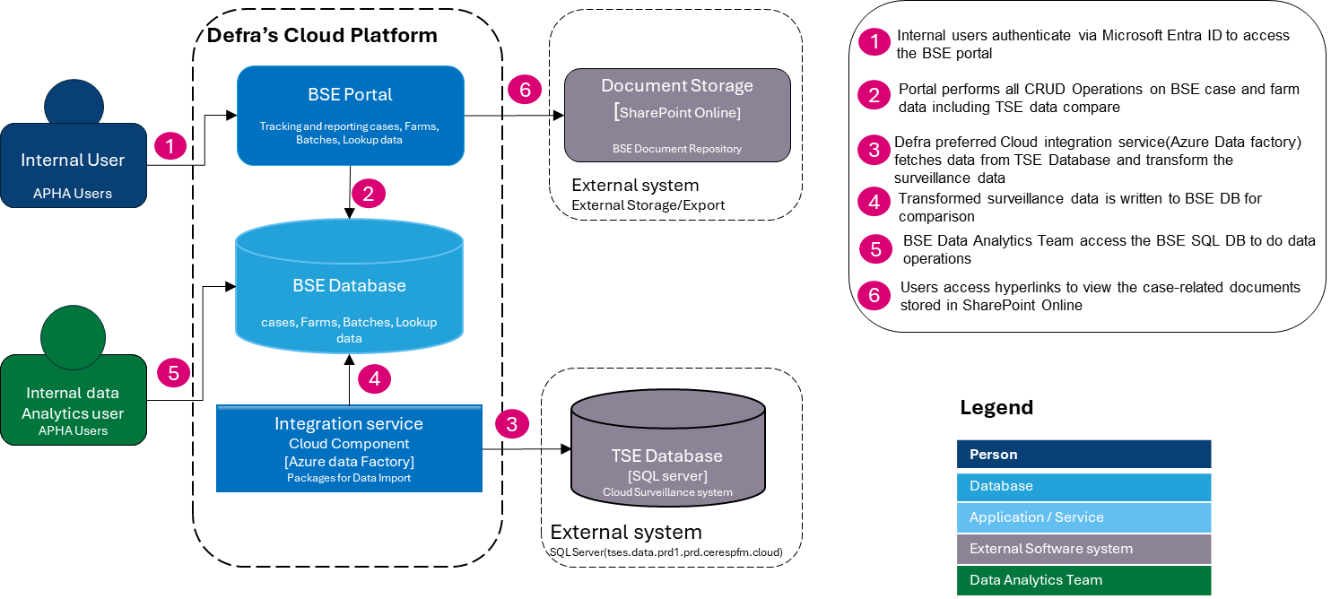
Logical Business Architecture

Slide 27
Principles Alignment

Slide 28
Enterprise Architecture Principles Alignment
Link to Principles on Architecture SharePoint Site, SSL Accessible Principles Link
Principle | Detail How the Design Aligns to the Principle
1. Delivery-Focused Architecture | Clear Scope and Time-Bound Objective: The architecture is designed to enable modernisation of the legacy application to a cloud-native, containerised .NET 10 platform by Q3–Q4 2026, ensuring alignment with modernization goals. Iterative Discovery and Validation: The approach includes iterative engagement with business SMEs, LAP teams, and Cognizant partners to validate assumptions and fill gaps in legacy knowledge. Governance Embedded: The architecture is being developed in alignment with Defra’s SDA, TDA, and CTWG governance processes, with resources allocated to support approval and refinement.
2. Design for Users | Business Analysis: The design incorporates insights from current usage patterns of the BSE application, ensuring that user workflows are preserved while improving efficiency. Support for Testing and Validation: The architecture introduces dedicated test environments, addressing the current limitation where validation occurs in production. Simplification of Data Journeys: The solution aims to streamline manual processes and fragmented IIS configurations into a cloud-native, automated platform, reducing complexity for users.
3. Maximise Value, Minimise Waste | Decommissioning of Legacy Components: The migration removes reliance on Windows Server 2016, IIS 10, and manual configurations, reducing operational overhead and future licensing costs. Consolidation of Fragmented Solutions: Current multiple IIS application pools and manual scripts will be consolidated into a single, maintainable architecture. Cloud-Native Design: The proposed solution aligns with Defra’s Cloud Centre of Excellence (CCoE) strategy, enabling scalability, maintainability, and cost-effective hosting.

Slide 29
Enterprise Architecture Principles Alignment
Link to Principles on Architecture SharePoint Site, SSL Accessible Principles Link
Principle | Detail How the Design Aligns to the Principle
4. Clean Data, Clear Decisions | Single Source of Truth: The architecture will consolidate all application configurations and dependencies discovered during the discovery phase into a unified repository. Data Mapping: Mapping will clarify which components are active, redundant, or require remediation, reducing unknown dependencies. Data Quality and Testing: Plans include regression testing and validation of data flows to ensure accuracy and reliability post-migration.
5. Connect and Collaborate | Landscape complexity: The architecture acknowledges the complexity of the current environment, involving multiple stakeholders and legacy dependencies. Coordinated Governance and Approval: Developed in alignment with Defra’s governance processes (SDA, TDA, CTWG), ensuring shared responsibility and transparency. Knowledge Consolidation: Documentation from current IIS configurations and operational practices will be consolidated to create a single source of truth.
6. Secure Today, Safe Tomorrow | Secure-by-Design: The new architecture will embed security controls aligned with Defra’s approved security frameworks. Cloud-Native Security Architecture: Designed to meet CCoE standards, ensuring scalability and resilience against evolving threats. Move to Aligned Technologies: The move away from unsupported legacy technologies to modern, secure cloud-native services ensures the platform remains safe and supportable in the future.

Slide 30
Enterprise Architecture Principles Alignment
Link to Principles on Architecture SharePoint Site, SSL Accessible Principles Link
Principle | Detail How the Design Aligns to the Principle
7. Empower to Innovate | Removal of Legacy Constraints: Eliminating manual IIS configurations and outdated OS creates space for automation and innovation. Supportability and Scalability: The architecture is designed for maintainability and scalability, reducing technical debt for future teams. Foundations for Future Capability: Moving to a CCoE-managed platform enables integration with modern DevOps practices and future enhancements.
8. Right Tools, Right Place | Strategic Platform: The architecture will be aligned with Defra’s approved technologies and cloud design templates, ensuring platform suitability and long-term sustainability for the migrated application. Fit for Purpose Technology Stack: The current system relies on Windows Server 2016 and IIS 10, with manual configurations and fragmented application pools. The new solution consolidates these into a cloud-native architecture appropriate to the scale and complexity of the service. DevOps Pipeline: The architecture ensures that modern tools such as Azure DevOps, CI/CD workflows, and automated deployment pipelines are implemented across development, testing, and production stages, replacing manual processes and reducing operational risk.

Slide 31
Appendices

Slide 32
A1 - RAID Catalogue

Slide 33
Risks
Ref | Title | Description | RAG | Impact | Mitigation
R-001 | Direct Database Access via SSMS | End users connecting directly to the production SQL Server environment using SQL Server Management Studio (SSMS) via AVD in read-only mode, potentially bypassing application‑level controls and gaining access to sensitive data or executing unauthorized queries. | Amber | Medium | Provide controlled reporting interfaces; implement audit logging; educate users on secure data access practices; review permissions periodically.
R-002 | Security vulnerabilities | BSE system is often outdated and unpatched, making cloud transitions high‑risk if not secured. | Red | High | Leverage cloud provider security features with identity hardening, zero‑trust control & encryption

Slide 34
Assumptions
Ref | Title | Description | RAG | Impact | Mitigation
A-001 | Full Application & Data Access | Will have access to full source code database schemas build scripts | Green | Low | Confirm receipt of all artifacts during discovery; validate build process independently; store in Defra’s secure repo; document build/run instructions.
A-002 | No Functional Change | Only infrastructure ownership will change — not UI or functional behaviour. | Green | Low | Validate functional parity in UAT; regression testing; maintain rollback plan.
A-003 | Defra Security Policies will be applied | Identity, access management, and auditing will align with Defra policies, | Amber | Medium | Apply Defra IAM standards (MFA, Conditional Access); enable audit logging;
A-004 | Azure Environment Availability | Defra’s Azure environment and governance framework are established and available for the project. | Green | High | Verify environment readiness and document current configurations.
A-005 | CCoE Compliance | All infrastructure and integrations comply with CCoE standards, tagging conventions and security baselines. | Green | High | Review compliance early and continuously with the CCoE team.

Slide 35
Issues
Ref | Title | Description | RAG | Impact | Mitigation
I-001 | CI/CD Pipeline | Defra now requires: build pipeline test automation (minimum smoke tests) release approval process | Amber | Green | Set up CI/CD pipeline using Azure DevOps or GitHub Actions; Automate build and smoke tests; Define gated approvals for releases; Document deployment and rollback steps.
Dependencies
Ref | Title | Description | RAG | Impact | Mitigation
D-001 | Final Handover Package from Civica | Must include: source code environments documentation database dumps scheduled tasks(if any) SSL certificates (if any) | Amber | High | Define a detailed handover checklist with acceptance criteria; Schedule a joint walkthrough and transfer session; Validate build from source in Defra repos; Verify database dump restore in UAT; Export and inventory scheduled tasks/SSIS jobs; Collect SSL/TLS certs + keys, note expiry, and re-issue via Defra PKI if needed.
D-002 | Defra Operational Teams | Teams impacted: BSE Casework Defra IT Ops All must agree on: new processes escalation routes downtime windows | Amber | Medium | Convene a RACI workshop to define roles/responsibilities; Publish runbooks (deploy, rollback, incident, DR); Agree and communicate maintenance/downtime windows; Set escalation matrix and on-call rotations; Rehearse UAT incident and cutover scenario.
D-003 | Accessing TSE (TSES) database via Self-Hosted Integration Runtime (SHIR) [REVISED] | Connectivity may fail if the Defra VM/SHIR is unavailable, misregistered with ADF, or if IBM has not whitelisted the Defra VM's outbound IP; direct ADF-managed-service connectivity to TSES is no longer used and all traffic must traverse the Defra VM. [REVISED] | Amber | Medium | Establish private connectivity (VNet peering/ExpressRoute/VPN + Private Endpoint), implement and validate UDRs to ensure symmetric routing, set least‑privilege NSG rules (source: CCoE subnets/ASGs → destination: TSES DB/PE, required TCP ports only), align TSES firewalls/ACLs to allow CCoE ranges/PE NICs, run pre‑prod/prod connectivity tests and enable connection monitoring/flow logs with SIEM alerts, manage all rules via IaC with change control and joint CCoE-TSES approvals, and maintain runbooks/RTO-RPO; provision the Defra VM using a burstable B-series SKU (consistent across Dev/Test/Pre-Prod/Prod, sized for the once-daily batch load), ensure the Defra network team adds the FortiGate hub firewall rule, and obtain IBM's confirmation of the outbound IP whitelist per environment before cutover. [REVISED]

Slide 36
A2 – Non-Functional Requirements

Slide 37
Non-Functional Requirements
Req' ID | Requirement Type | Description
NFR - 001 | Service level Availability | The system should maintain an uptime of at least 98.5%, in alignment with Tier 3 service level expectations.
NFR - 002 | Recovery Point Objective(RPO) | They system must ensure that, in case of a failure, no more than 4 hours of data lost, in alignment with Tier 3 services levels.
NFR - 003 | Recovery Time Objective(RTO) | The system must recover and be fully operational within 4 hours after a failure, as required under Tier 3 service levels.
NFR – 004 | Operational Hours | The system must be fully available for end‑users during standard business hours, operating between 09:00 and 17:00 GMT/BST, Monday to Friday.

Slide 38
A3 - Costing

Slide 39
Infrastructure Costing
Approximate cost of infrastructure based on standard assumptions
Service category | Service type | Region | Resilience | Description | Estimated Monthly Cost (approx.)
 |  |  |  |  | Dev | Test | Pre Prod | Prod
Databases | Azure SQL Database | UK South | Geo-redundant / Multi-region *ZRS ( will be good to go) | Zone Redundant Database, vCore, General Purpose, Serverless, Standard-series (Gen 5), max 2 vCores, ZRS Back up Storage Redundancy, Memory : Autoscale (1 vCore ≈ 3 GB RAM) [PRE|PROD] 8 vCores, max Storage 200GB | £180.00 | £180.00 | £350.00 | £350.00
Compute | Azure Container Apps | UK South | Zone‑Redundant (ZRS) | Consumption + Dedicated Plan; Linux containers (.NET 10); 2 vCPU(s), 4 GB RAM per replica; min 1, max 3 replicas; Includes autoscaling. | £185.00 | £185.00 | £200.00 | £200.00
Compute | Azure Virtual Machine (SHIR host) | UK South | Single node across all environments | Windows Server VM hosting Self-Hosted Integration Runtime (SHIR) for ADF-to-TSES connectivity. Burstable B-series SKU (e.g. Standard_B2ms) - same SKU across all environments given consistent once-daily batch load; accumulates credit while idle, bursts during the batch run. | £55.00 | £55.00 | £55.00 | £55.00
Data Integration | Azure Data Factory | UK South | Zone‑Resilient | Azure Data Factory V2 Type, 8vCores [PRE|PROD] 16 vCore | £100.00 | £100.00 | £200.00 | £200.00
Monitoring | Azure Monitor | UK South | Default | Azure App Insight Application Insights: 1 GB Daily Analytics logs ingested, 3 months Data retention, 1 Standard Web Test, 5 Minutes Execution frequency, Executing for 730 hours; | £60.00 | £60.00 | £60.00 | £60.00
Security | Key Vault | UK South | Default | 100-200 TPS | £25.00 | £25.00 | £25.00 | £25.00
Networking | Azure Private Endpoints | UK South | Default | 3 in total . 1 Endpoints X 730 Hours, 100 GB Outbound data processed, 100 GB Inbound data processed | £30.00 | £30.00 | £30.00 | £30.00
Total |  |  |  |  | £635.00 | £635.00 | £920.00 | £920.00
Grand Total |  |  |  |  | £3,110.00

Slide 40
A4 – Security Policy & Firewalls

Slide 41
Architecture Future State
High Level To-Be: Firewalls & Security Rules
1. Firewall & Security
Rule Name | Priority | Direction | Source | Destination | Protocol/Port | Action | Purpose / Notes
Inbound-HTTPS-to-App-Entry | 100 | Inbound | Internet | App Entry (AppGW/WAF or Firewall PIP) | TCP/443 | Allow | User HTTPS entry to BSE app; DNAT or AppGW → App tier
Inbound-DNS-to-DNSForwarder | 110 | Inbound | Spoke VNets | Hub DNS forwarder(s) | UDP/TCP 53 | Allow | Centralized DNS resolution
Outbound-AD-Auth | 200 | Outbound | Spokes + Hub | FQDN tags: AzureActiveDirectory, MSGraph | TCP/443 | Allow | Entra ID login and token validation
Outbound-Microsoft-Identity | 205 | Outbound | Spokes + Hub | login.microsoftonline.com, sts.windows.net | TCP/443 | Allow | Explicit AAD endpoints if not using tags only
Outbound-AzureSQL | 210 | Outbound | App Subnet, ADF IR | Azure SQL (Private Endpoint preferred) | TCP/1433 | Allow | App/ADF to SQL; prefer Private Endpoint
Outbound-Storage | 220 | Outbound | App/ADF | FQDN tag: Storage | TCP/443 | Allow | Access Blob/File/Queue/Table; prefer Private Endpoints
Outbound-KeyVault | 230 | Outbound | App/ADF | FQDN tag: AzureKeyVault | TCP/443 | Allow | Secret retrieval; prefer Private Endpoint
Outbound-Monitoring | 240 | Outbound | All Subnets | FQDN tags: AzureMonitor | TCP/443 | Allow | Logs/metrics export
Outbound-CRL-Time | 250 | Outbound | All Subnets | time.windows.com; ocsp.msocsp.com; crl.microsoft.com | UDP/123, TCP/80/443 | Allow | Time sync & certificate revocation/OCSP
Outbound-3P-API | 260 | Outbound | App Subnet | 3rd‑party API FQDN(s) | TCP/443 | Allow | Partner API access; restrict by FQDN
Outbound-SHIR-to-TSES | 270 | Outbound | Defra VM (SHIR) / Data Sync | TSES DB / AWS RDS (via Hub/FortiGate; IBM whitelists the route) | TCP/1433 (or custom) | Allow | Scheduled data pulls via SHIR VM, routed through the Hub; requires a FortiGate rule (Defra network team) plus IBM whitelisting of the route to TSES DB
Deny-Internet-Egress-Default | 65000 | Outbound | All Subnets | Internet | Any | Deny | Default deny egress (use allowlist above)
Deny-Inbound-Default | 65001 | Inbound | Any | Any | Any | Deny | Default deny inbound
2. Ingress Path
Hop | From → To | Control | Port | Action | Notes
1 | Internet → Hub (AppGW/WAF or Firewall PIP) | Azure Firewall / AppGW WAF | TCP/443 | Allow | HTTPS only; WAF policies
2 | Hub Ingress → App Subnet | NSG (App) | TCP/443 | Allow | Health probes from AppGW subnet
3 | App → Entra ID endpoints | Firewall egress | TCP/443 | Allow | Login redirect & token validation
3. Egress Path
Source | Destination | Via | Port(s) | Rule
App | Azure SQL (PE) | Spoke NSG | 1433 | Allow
ADF (via SHIR on Defra VM) | TSES DB (AWS RDS, IBM AWS) | Defra VM egress -> IBM firewall whitelist | 1433 (or custom) | Allow
App/ADF | Key Vault (PE) | Spoke NSG | 443 | Allow
App/ADF | Storage (PE) | Spoke NSG | 443 | Allow
App | 3rd‑party API | Firewall | 443 | Allow (FQDN‑limited)
All | Internet (general) | Firewall | Any | Deny except approved FQDN tags
Notes:
Costing for new service based on above architecture

Slide 42
A5 – Service Design, GDS & Compliance Summary

Slide 43
Service Design, GDS & Compliance Summary
Accessibility Compliance Statements ☐ The supplier must not introduce any new WCAG 2.2 AA accessibility regressions during the migration. ☐ The supplier must complete and provide results from WCAG 2.2 AA accessibility testing. ☐ The supplier must confirm that the existing accessibility statement remains accurate post‑migration.
GOV.UK Design System Compliance Statements ☐ The supplier must ensure no changes are made to the UI that break current GOV.UK‑aligned behavior. ☐ The supplier must ensure the migrated platform remains technically ready for future GOV.UK Design System adoption in 2026.
Privacy Compliance Statements ☐ The supplier must confirm no new personal data will be collected or processed as part of the migration. ☐ The supplier must confirm that encryption in transit (TLS 1.2+) and encryption at rest are fully implemented. ☐ The supplier must confirm the current DPIA remains valid and no new privacy risks have been introduced.
Security Compliance Statements ☐ The supplier must ensure alignment with Defra Secure‑by‑Design controls. ☐ The supplier must configure Cloud KMS-managed encryption for all data stores. ☐ The supplier must ensure logging and monitoring is in place.
GDS Compliance Statements ☐ The supplier must demonstrate alignment to each of the 14 points of the GDS Service Standard. ☐ The supplier must confirm no functional changes will be introduced during migration. ☐ The supplier must confirm that existing user journeys will be preserved until the 2026 rewrite.

Slide 44
A6 – Glossary

Slide 45
Glossary
Acronym | Definition
ALB | Arm's Length Body
AWS | Amazon Web Services
AZURE | Microsoft Cloud Platform
BAU | Business as Usual
BDAT | Business, Data, Application & Technology
BLOB | Binary Large Object
CCoE | Cloud Centre of Excellence
CMDB | Configuration Management Database
CTWG | Cloud Technology Working Group
Data Lake | A system or repository of data stored in its natural/raw format
DC | Data Centre
DDTS | Digital, Data & Technology Services
DEFRA | Department for Environment, Food & Rural Affairs
DevOps | Development (Dev) & Operations (Ops)
DP | Data Protection
EA | Environment Agency
GAWG | Geospatial Architecture Working Group
GB | Gigabyte
GDPR | General Data Protection Regulation
GIAA | Government Internal Audit Agency
GIO | Group Infrastructure and Operations
H&AS | Hosting and Application Services (project) - ATOS
HLD | High-Level Design
HTTPS | HyperText Transfer Protocol Secure
IaaS | Infrastructure as a Service
LAP | Legacy Application Program
LITP | Livestock Information Transformation Programme
LLD | Low Level Design
M365 | Microsoft 365
MB | Megabyte
MVP | Minimum Viable Product
NE | Natural England
OOS | Out of Scope
PaaS | Platform as a Service
PII | Personally Identifiable Information
RACI | Responsible, Accountable, Consulted, Informed
RBAC | Role-based Access Control
ROM | Rough Order of Magnitude
RPA | Rural Payments Agency
SaaS | Software as a Service
SACM | Service Asset & Configuration Management
SFTP | Secure File Transfer Protocol
SIT | System Integration Testing
SME | Subject Matter Expert
SSO | Single Sign On
TB | Terrabyte
TDA | Technical Design Authority
TGB | Technology Governance Board
TIWG | Technical Integration Working Group
UAT | User Acceptance Testing
UMAL | Unified Master Application List

Slide 46
End

